Slide 1
Biology
Unit 3 Matter and Energy in Living Systems
Lesson 4: Cycling of Matter and Energy in Ecosystems
Notes:
Lesson Objective
Model the flow of matter and energy through biogeochemical cycles, and analyze the impacts of human activities on these cycles.

Slide 2

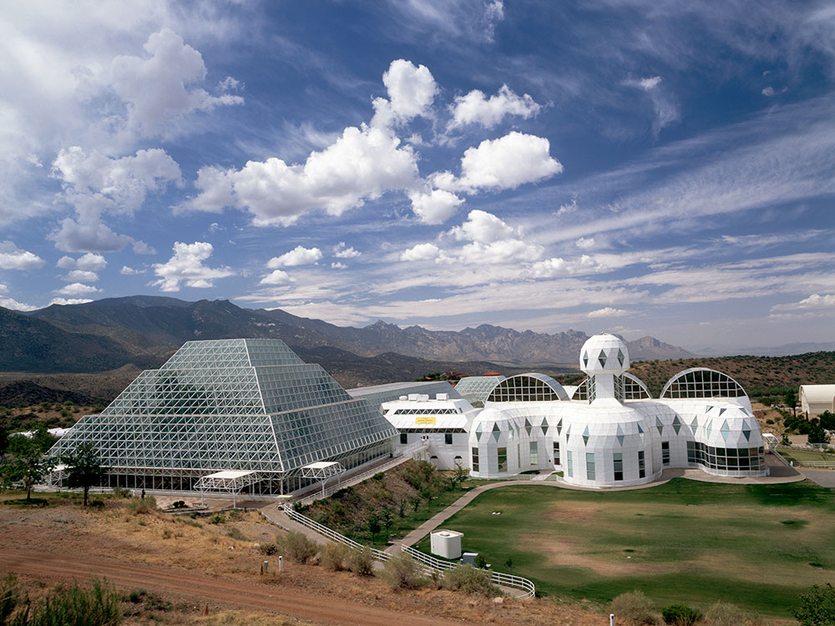
Can You Explain It?
Unit 3 Lesson 4
Why do you think researchers had problems with low oxygen levels and increasing carbon dioxide levels in Biosphere 2? How would you solve this problem?

Slide 3
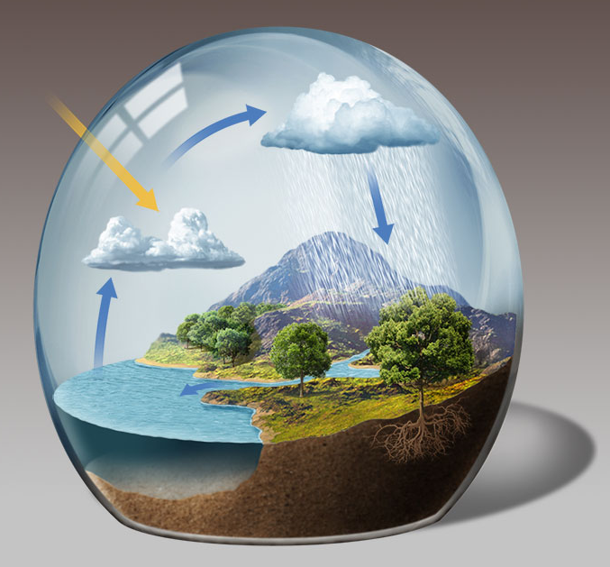
Matter Cycles Through Ecosystems
Unit 3 Lesson 4
Earth is an open system in terms of energy, as it gains energy from the sun. In contrast, Earth is a closed system in terms of matter.
The Earth system includes all of the matter, energy, processes, and cycles within Earth's boundary with space.

Slide 4
Matter Cycles Through Ecosystems
Unit 3 Lesson 4
EXPLAIN
If the total amount of water on Earth does not change, why are there concerns about global freshwater shortages?

Slide 5
Matter Cycles Through Ecosystems
Unit 3 Lesson 4
A biogeochemical cycle is the movement of a particular chemical through the biotic and abiotic components of an ecosystem.
Each cycle on Earth interacts with other cycles. For example, the water cycle interacts with the oxygen cycle, because water is necessary for photosynthesis.
Some of the carbon in the organic matter may become fossilized. Under certain conditions, the burial process stores that carbon in Earth's crust where, over millions of years, it becomes fossil fuel.

Slide 6
Matter Cycles Through Ecosystems Scale Proportion and Quantity
Unit 3 Lesson 4
EXPLAIN
Legumes are often planted and harvested as crops. When this happens, the plants are not left to decompose into the soil. How does removing the legumes from the ecosystem affect the nitrogen cycle?

Slide 7
Matter Cycles Through Ecosystems
Unit 3 Lesson 4
EXPLAIN
How do the hydrologic cycle and the different biogeochemical cycles relate to one another? How can a change in one cycle affect all of the other cycles?

Slide 8
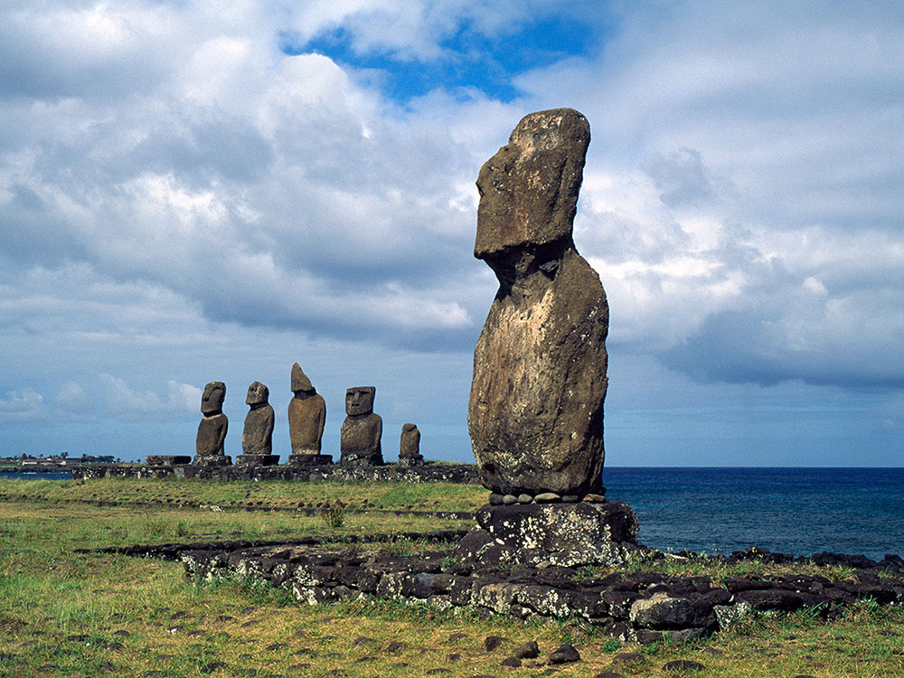
Human Impact on Earth's Cycles
Unit 3 Lesson 4
What effect did the human population have on Easter Island? How did they change the island's natural cycling of matter and energy?

Slide 9
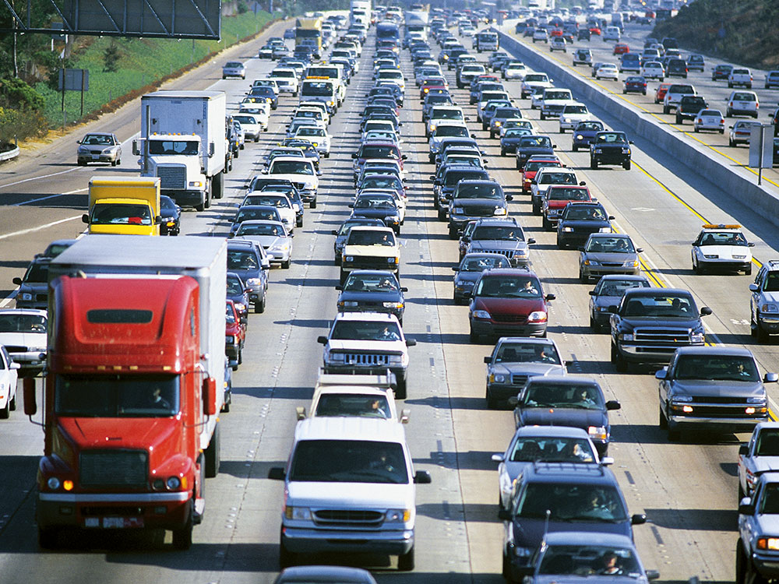
Human Impact on Earth's Cycles
Unit 3 Lesson 4
Without human activity, the cycling of carbon, phosphorus, and nitrogen in the Earth system would be in a relatively steady state.
The most common air pollution comes from the waste products produced by burning fossil fuels.

Slide 10
Human Impact on Earth's Cycles Cause and Effect
Unit 3 Lesson 4
EXPLAIN
Make a model describing how over-fertilizing leads to. eutrophication. Then, use your model to suggest one possible solution to this problem.

Slide 11
Human Impact on Earth's Cycles
Unit 3 Lesson 4
EXPLAIN
Many scientists worry that the influence humans have on the biogeochemical and hydrologic cycles will cause lasting damage to Earth. Make a list of the activities you perform in a day that may impact one of these cycles. Explain how you are interacting with the cycle and how that could be affecting your local ecosystem. What can you do to decrease your impact?

Slide 12
Can You Explain It?
Unit 3 Lesson 4
Refer to the notes in your Evidence Notebook to explain how matter changes form as it flows within the Biosphere 2 system. Use this information to help you answer the following questions:
How do matter and energy change form as they cycle through ecosystems and Earth's spheres?
Why do you think researchers had problems with low oxygen in Biosphere 2?
How would you solve this problem?

Slide 13
Image Credits
Unit 3 Lesson 4
Biosphere 2 ©James Marshall/Getty Images; traffic on freeway ©Comstock Images/Jupiterimages/Getty Images; Easter Island, Chile ©Guido Cozzi/Atlantide Phototravel/Corbis

